Slide 1
Angular Routing
Routing to Features
Lecture 2
By James(Jin) Wang
12/26/2021

Slide 2
Outline
Setting up for Feature Routing
Route Path Naming Strategies
Activating a Route with Code
Accessing Feature Routes
Defining a Routing Module

Slide 3

Setting up Feature Routing
  Feature Module

Slide 4
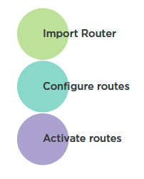
Setting up Feature Routing
  Setting up for Feature Routing

Slide 5
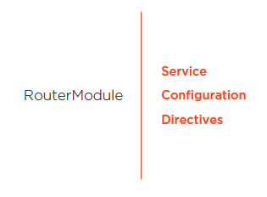
Setting up Feature Routing
  Importing the Angular Router

Slide 6
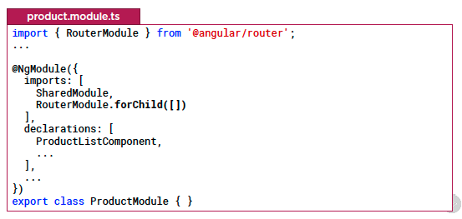
Setting up Feature Routing
  Importing the Angular Router
  Demo: Router

Slide 7
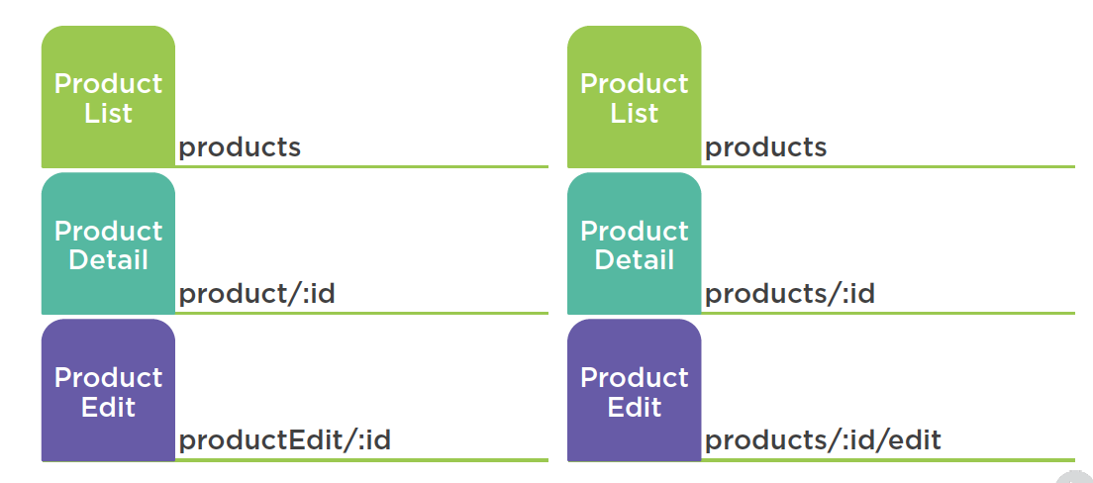
Setting up Feature Routing
  Route Path Naming Strategies

Slide 8
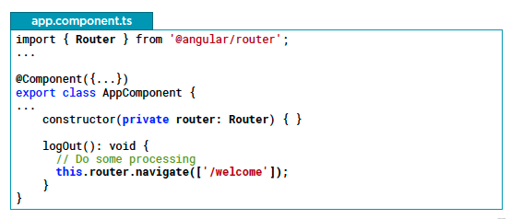
Setting up Feature Routing
  Activating a Route with Code
  Demo: activate a Route with Code

Slide 9
Summary

Slide 10
Assignment

Slide 11
Self Study
  Angular Routing
  https://app.pluralsight.com/library/courses/angular-routing

